Slide 1
UDDI -STRUCTURE
Prof. M.Sudha
Unit-4

Slide 2
UDDI has two parts:
A registry of all a web service's metadata including a pointer to the WSDL description of a service
A set of WSDL port type definitions for manipulating and searching that registry
Prof. M.Sudha

Slide 3
Structure
<business Entity>
name, contacts,
descriptions, categories
<t Model>
Name
Description
URL pointers
<business Service>
(1..n)
<binding Template>
Business Entity is a top level information manager for the business unit – serves as white and yellow pages
Prof. M.Sudha

Slide 4
Structure (II)
Business service and Binding template define the green pages
businessService structure describes a group of related Web services
bindingTemplate consists of the information required to invoke services.
tModel contains information about specification supported for compatibility.
Prof. M.Sudha

Slide 5
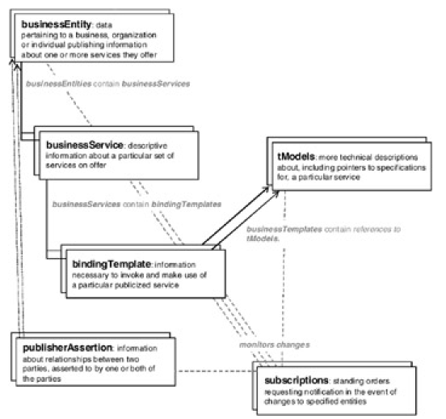
UDDI Data Structure
Prof. M.Sudha

Slide 6
UDDI Data Structure
1. Business information pertaining to a business or organization providing one or more services which, in the context of the UDDI model, is referred to as the “business Entity”
2. Sets of related services (e.g., a set of Web services concerning purchase order processing and another set concerning online inventory checking) being offered by a previously described business or organization which are referred to as “business Service” elements
Prof. M.Sudha

Slide 7
Ctd.,
3. The binding information necessary to invoke and make use of a particular, previously described,
service (whether a Web service or otherwise)referred to as a “bindingTemplate” element
4. More technical information (or even a technical blueprint) about a service, over and above the binding information necessary to connect to it, such as pointers to detailed specifications, protocols used by the service (e.g., SOAP, HTTP, or SMTP in the case of a Web service), and possible type classification for that service which is known as a “technical model” (tModel)
Prof. M.Sudha

Slide 8
Ctd.,
These four core data structures have been a part of UDDI from the start.
They form the nucleus of what UDDI is all about.
Two other data structures have been added since,
one in UDDI Version 2
the other in Version 3.
These two data structures deal with:
Prof. M.Sudha

Slide 9
Ctd.,
Relationships between business or organization entities (e.g., certification, alliances, membership, trading partnerships, and so forth), asserted to by one or both of those entities. This data structure, “publisher Assertion,” was introduced with UDDI Version 2.
This data structure, used for such automated change notification which was introduced with UDDI Version3, is referred to as “operational Info.”
Prof. M.Sudha

Slide 10
UDDI Technical Architecture
The UDDI technical architecture consists of three parts:
UDDI data model:
An XML Schema for describing businesses and web services. The data model is described in detail in the "UDDI Data Model" section.
UDDI API Specification:
A Specification of API for searching and publishing UDDI data.
Prof. M.Sudha

Slide 11
UDDI cloud services:
This is operator sites that provide implementations of the UDDI specification and synchronize all data on a scheduled basis.
The UDDI Business Registry (UBR), also known as the Public Cloud, is a conceptually single system built from multiple nodes that has their data synchronized through replication.
The current cloud services provide a logically centralized, but physically distributed, directory.
Data submitted to one root node will automatically be replicated across all the other root nodes. Currently, data replication occurs every 24 hours.
Prof. M.Sudha

Slide 12
Ctd.,
UDDI cloud services are currently provided by Microsoft and IBM. Ariba had originally planned to offer an operator as well, but has since backed away from the commitment.
Additional operators from other companies, including Hewlett-Packard, are planned for the near future.
It is also possible to set up private UDDI registries.
For example, a large company may set up its own private UDDI registry for registering all internal web services.
As these registries are not automatically synchronized with the root UDDI nodes, they are not considered part of the UDDI cloud.
Prof. M.Sudha

Slide 13
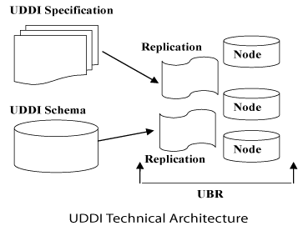
UDDI Technical Architecture
This is operator sites that provide implementations of the UDDI specification and synchronize all data on a scheduled basis.
Prof. M.Sudha

Slide 14
Summary : UDDI - Data Structure
UDDI includes an XML Schema that describes four five data structures:
businessEntity
businessService
bindingTemplate
tModel
publisher Assertion
Operational Info
Prof. M.Sudha

Slide 15
The main issues that UDDI
How an enterprise, whether a business or organization, identifies other enterprises around the world that may be able to provide it with necessary services (or goods)
How enterprises could describe themselves and the services they offered in a structured, systematic manner so as to attract prospects interested in such services
How an enterprise could sift through and narrow down its list of prospective service providers to those that best fit its needs
How one could obtain an accurate, detailed description of the services being offered by a selected Enterprise
How one could determine the mechanisms available for conducting e-business transactions with a selected enterprise
How one could realize all of the above using programmatic interfaces rather than having to do all of this manually using a user interface
Prof. M.Sudha

Slide 16
key factors that made search engines unsuitable for the purposes of UDDI
Search engines devoted all their efforts to locating and indexing just the URLs of the Web pages that contained keywords of interest.
Search engines did not make any effort to identify other identification or contact information such as e-mail addresses, FTP sites, or even phone numbers.
Search engines, even today, are very HTML-centric and URL specific.
Search engines specialize in doing free text searches against unstructured data, whereas UDDI wished to promulgate structured data models.
Search engines, in general, do not offer a no-charge, self-service, publishing mechanism whereby enterprises or individuals can enter specific information that they wish to publicize.
Search engines, even today, do not typically offer programmatic access to the services they offer.
Search engines have yet to become XML savvy.
Prof. M.Sudha

